Slide 1
Bandwidth measurement & analysis
EE533 Reading#2
Haoran Fan
USC ID: 9122-3344-95

Slide 2
1. Introduction
Goals:
Find bandwidth characteristics of network path
Insights into potential trends of bandwidth for estimation
Tools:
Platform: PlanetLab
Tools: pathrate

Slide 3
2. Measurement Analysis
Set 1:
Date: Aug 11th 2004 ~ Sep 6th 2004
PlanetLab Version: Version 2
Return Data: High Capacity Estimate
Set 2:
Date: Jan 5th 2005 ~ Jan 18th 2005
PlanetLab Version: Version 3
Return Data: High Capacity Estimate

Slide 4
2. Analysis - Overview
 | Set 1 | Set 2
# of Nodes | 279 | 178
# of pairs | 12006 | 21861
Min Capacity | 0.1 Mbps | 0.3 Mbps
Max Capacity | 1210.1 Mbps | 682.9 Mbps
Avg Capacity | 63.44 Mbps | 64,03 Mbps
Medium Capacity | 24.5 Mbps | 91.4 Mbps
Standard deviation | 119.22 Mbps | 43.78 Mbps
Difference may because of…
PlanetLab Version updated to v3
Infrastructure updated
Tools error

Slide 5
2. Analysis - Overview
 | Set 1 | Set 2
# of Nodes | 279 | 178
# of pairs | 12006 | 21861
Min Capacity | 0.1 Mbps | 0.3 Mbps
Max Capacity | 1210.1 Mbps | 682.9 Mbps
Avg Capacity | 63.44 Mbps | 64,03 Mbps
Medium Capacity | 24.5 Mbps | 91.4 Mbps
Standard deviation | 119.22 Mbps | 43.78 Mbps
Observation
Prefiltering of set 2 data nodes: extremely high/low nodes in set 1 are relatively unstable
Limited the number of nodes per site to 2 in Set 2

Slide 6
2. Analysis - Distribution
Capacity (Mbps) | Set 1 |  | Set 2
 | # of pairs | % | # of pairs | %
C < 20 | 4013 | 33.42 | 6733 | 30.8
20 < C < 50 | 4246 | 35.37 | 1910 | 8.74
50 < C < 80 | 674 | 5.61 | 1303 | 5.96
80 < C < 120 | 2193 | 18.27 | 11744 | 53.92
120 < C < 200 | 207 | 1.72 | 139 | 0.64
200 < C < 500 | 392 | 3.27 | 21 | 0.096
C > 500 | 281 | 2.34 | 11 | 0.05
Observation
Set 1: most under 50 Mbps
Set 2: most between 80 ~ 120 Mbps

Slide 7
2. Analysis – Asymmetry Factor
Formular
Meaning:
Test the bandwidth in bi-direction
If factor -> 0, it means that this path’s bandwidth is more symmetry for both direction

Slide 8
2. Analysis – Asymmetry Factor
Asymmetry Factor | Set 1 |  | Set 2
 | # of pairs | % | # of pairs | %
a < 0101 | 132 | 6.08 | 1943 | 21.49
0.01 < a < 0.05 | 395 | 18.19 | 3237 | 37.74
0.05 < a < 0.1 | 165 | 7.6 | 817 | 9.52
0.1 < a < 0.2 | 243 | 11.19 | 880 | 10.26
0.2 < a < 0.5 | 328 | 15.1 | 1111 | 12.95
0.5 < a | 909 | 41.85 | 870 | 10.14
Observation
Nodes in Set 2 is much more symmetry than Set 1
Possible Reason
PlanetLab Software version upgraded
Pathrate version
Question:
Can we say it infers that the infrastructure changes?

Slide 9
2. Analysis – Common Nodes
Capacity (Mbps) | Set 1 |  | Set 2
 | # of pairs | % | # of pairs | %
C < 20 | 1041 | 30.54 | 909 | 26.66
20 < C < 50 | 1491 | 43.74 | 103 | 3.02
50 < C < 80 | 105 | 3.08 | 180 | 5.28
80 < C < 120 | 587 | 17.22 | 2205 | 64.68
120 < C < 200 | 37 | 1.09 | 12 | 0.35
200 < C < 500 | 86 | 2.52 | 0 | 0
C > 500 | 62 | 1.82 | 0 | 0
Observation
Biggest Change: From 20 ~ 50 Mbps to 80 ~ 120 Mbps

Slide 10
2. Analysis – Common Nodes Factor
Asymmetry Factor | Set 1 |  | Set 2
 | # of pairs | % | # of pairs | %
a < 0101 | 65 | 9.83 | 145 | 21.94
0.01 < a < 0.05 | 167 | 25.26 | 299 | 45.23
0.05 < a < 0.1 | 57 | 8.62 | 86 | 13.01
0.1 < a < 0.2 | 64 | 9.68 | 70 | 10.59
0.2 < a < 0.5 | 83 | 12.56 | 48 | 7.26
0.5 < a | 225 | 34.04 | 13 | 1.97
Observation
Significant reduced asymmetry factor for Set 2

Slide 11
2. Analysis - Correlation Study
Goals
Find if there is possible correlation between latency and bandwidth
Method
Find closest nodes – shortest latency
Find max bandwidth
Ratio of max bandwidth to bandwidth to shortest latency node’s bandwidth
If closer to 1, means the correlation between bandwidth and latency is stronger

Slide 12
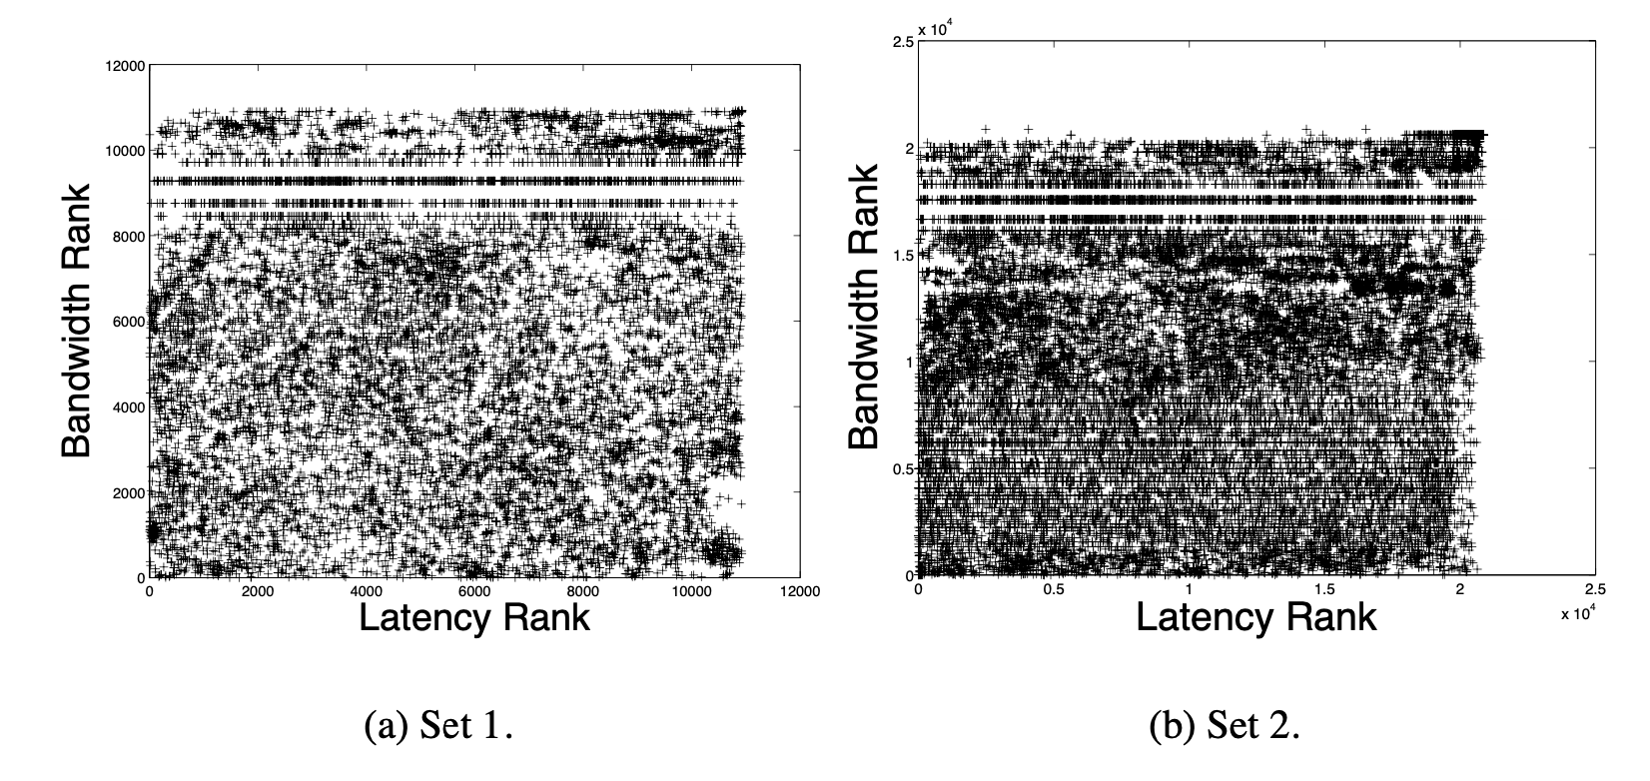
2. Analysis - Correlation Study
Observation
Did not find such correlation
Conclusion
Might have more degree of rank-order correlation

Slide 13
3. Summary & Conclusion
Present data:
Large scale measurement
end-to-end capacity of path between PlanetLab nodes
Tools
PlanetLab
Pathrate
Conclusion
Capacity of Path
An order of magnitude difference
Capacity Symmetry is not necessary
Bandwidth limited implemented
Correlation between latency and bandwidth should be investigate in the future

Slide 14
Thanks for watching
EE533 Reading#2
Haoran Fan
USC ID: 9122-3344-95

